Slide 1
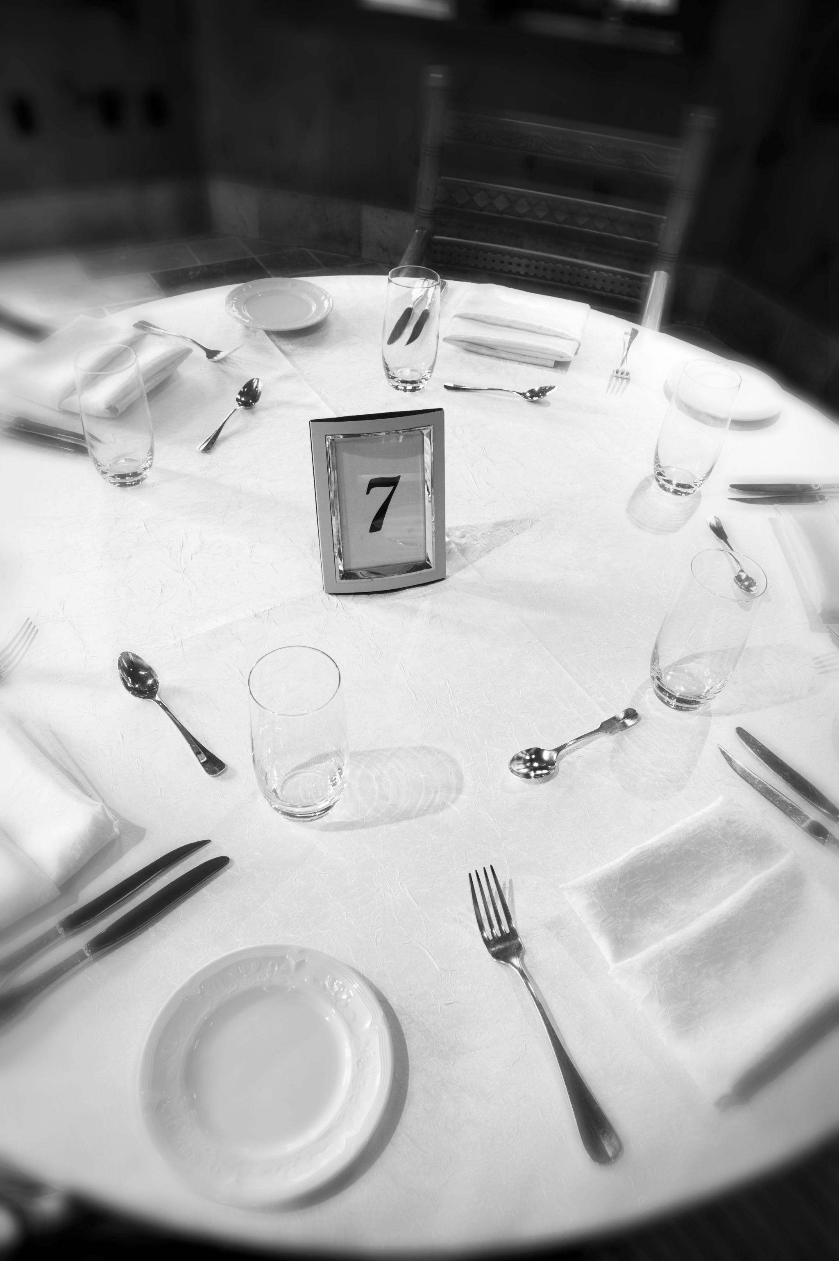
Municipal Event Risk Management
Understanding event types and municipal roles
Insurance liability and coverage essentials
Safety protocols for vendors and venues
Emergency planning and security measures
Traffic control and crowd management strategies

Slide 2

Types of Municipal Events
Municipal-Sponsored Events
  These events are organized and funded entirely by the local government, with full municipal oversight and responsibility.
Third-Party Events on Municipal Property
  External groups manage these events, while the municipality provides only the venue. The third party handles planning and execution.
Joint Municipal and Third-Party Events
  Both the municipality and a third party share planning, responsibilities, and resources, combining efforts for event success.
Permitted Events
  Events organized by outside groups that require a permit from the municipality.

Slide 3
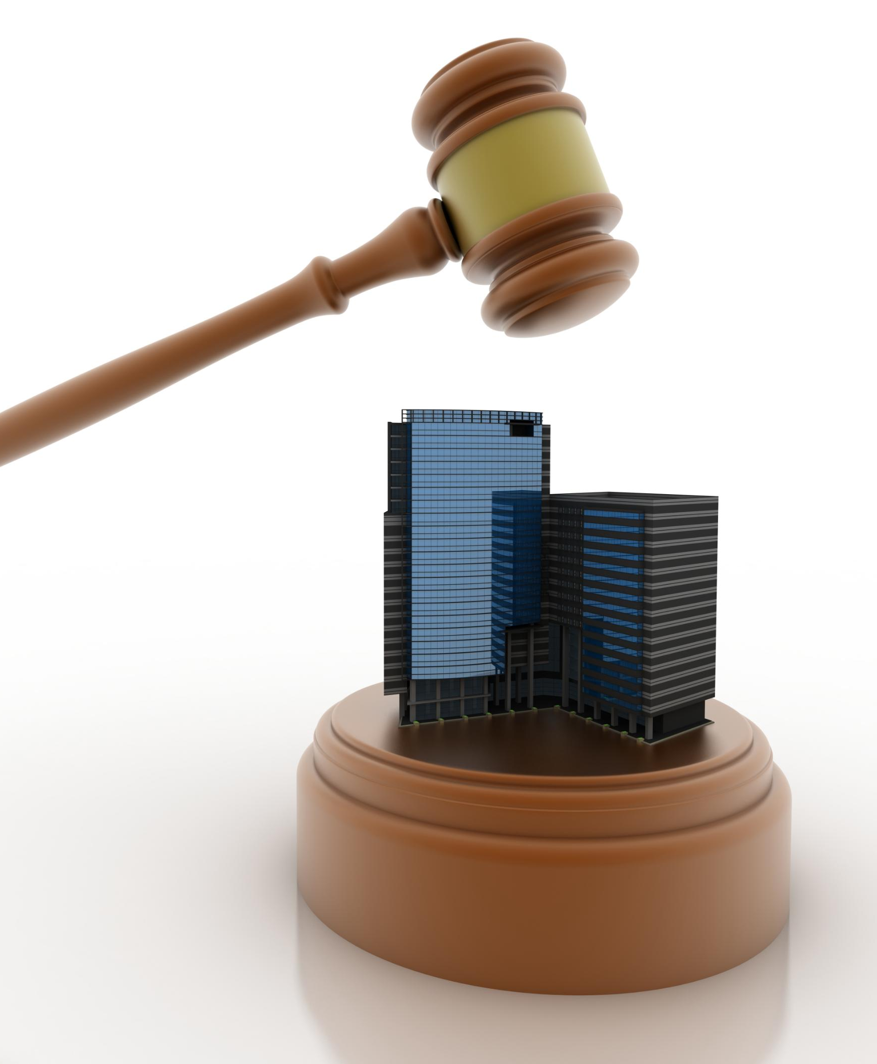
Insurance Liability Differences
Municipal-Sponsored Events
When an event is sponsored by the municipality, the liability usually rests with the municipality, necessitating municipal insurance to cover any potential claims.
Third-Party Events
For events hosted by third parties on municipal property, the responsibility for liability lies with the event organizers, who must demonstrate adequate insurance coverage.
Jointly Sponsored Events
In cases of joint sponsorship, liability is shared, requiring coordinated insurance arrangements and clearly assigned responsibilities between the involved parties.
Permitted Events
Typically, the event organizer holds liability; however, there are instances where the municipality issuing the permit may also bear some liability.

Slide 4

Third Party Events
Just the Venue Provider: Make sure any advertising or signage doesn’t present the event as municipal sponsored. The organizer should be clearly identified as the event host, so liability stays with them.
Cost Recovery: If municipal services are needed (e.g. police for traffic control), use an off-duty detail or charge the organizer for those services per the agreement. The organizer’s insurance should cover those personnel as well.
Maintain Regulatory Authority: The municipality can stop the event or parts of it if there are serious public safety violations (overcrowding, illegal activity, etc.), but this is done in its capacity as a regulator, not as the event manager. Document any interventions.

Slide 5
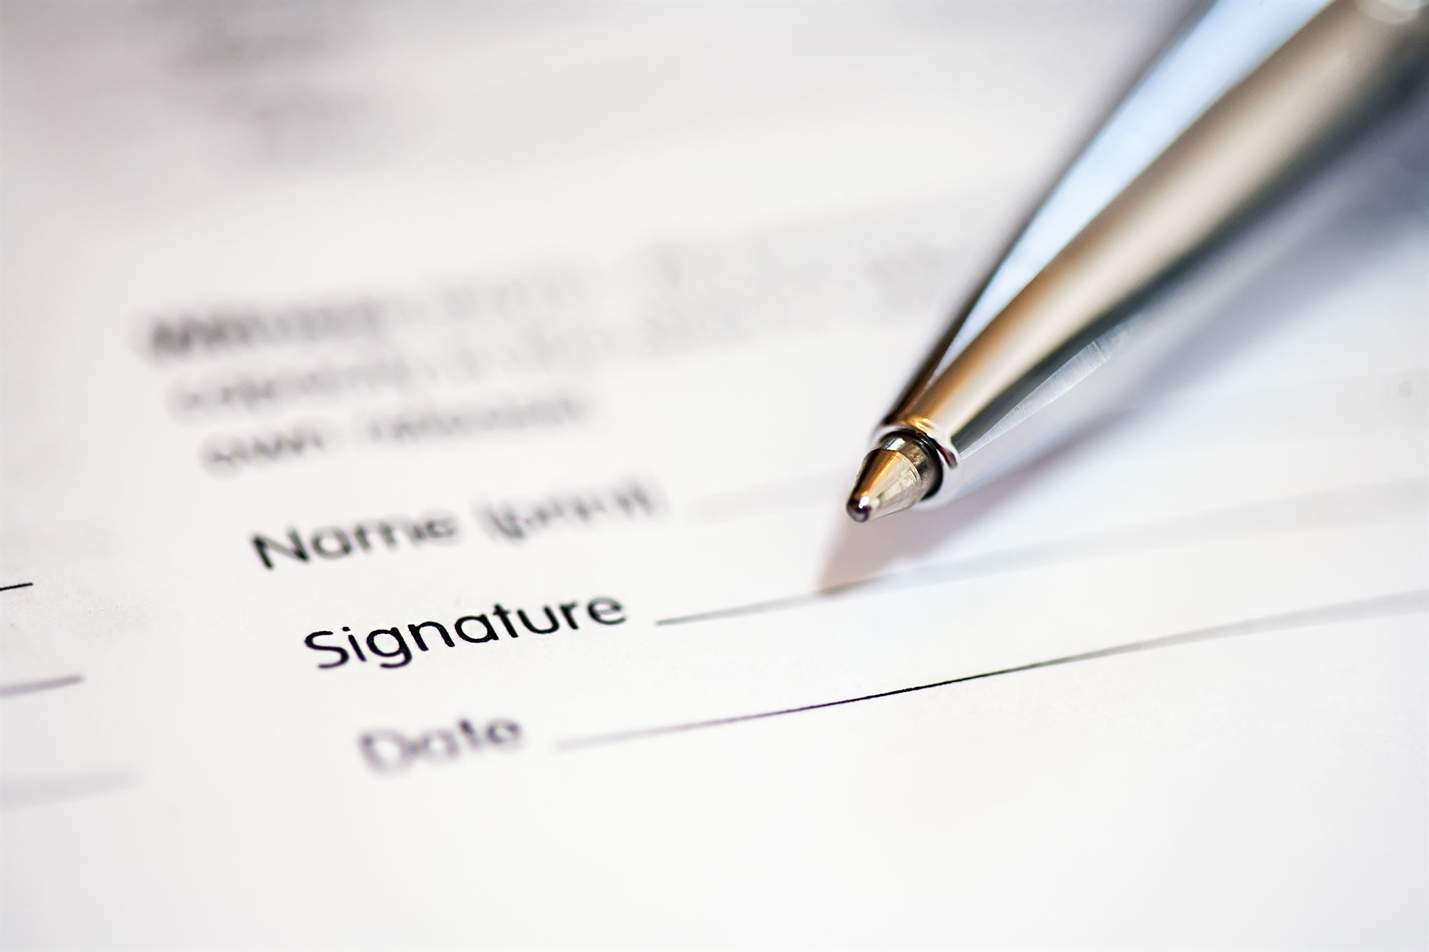
Key Insurance Requirements for Event Organizers
Event organizers must name the municipality as an additional insured on their liability policy per a written agreement, contract or permit.
No event should be allowed without proof of required insurance coverage.
Special coverages like liquor or fireworks liability are required when applicable.
Vendors should also have insurance policies naming the municipality as additional insured.

Slide 6
Essential Event Insurance
Liability Coverage
Liability insurance protects event organizers against claims of injury or property damage, ensuring financial security and compliance. Depending on the event proof of insurance for varies lines of coverage will be needed.
Additional Event Coverages
Policies often include cancellation, equipment, and workers’ compensation coverage for more comprehensive risk management.
Proof and Policy Review
Venues and authorities require proof of insurance. Reviewing limits and adding insured parties ensures thorough protection.

Slide 7
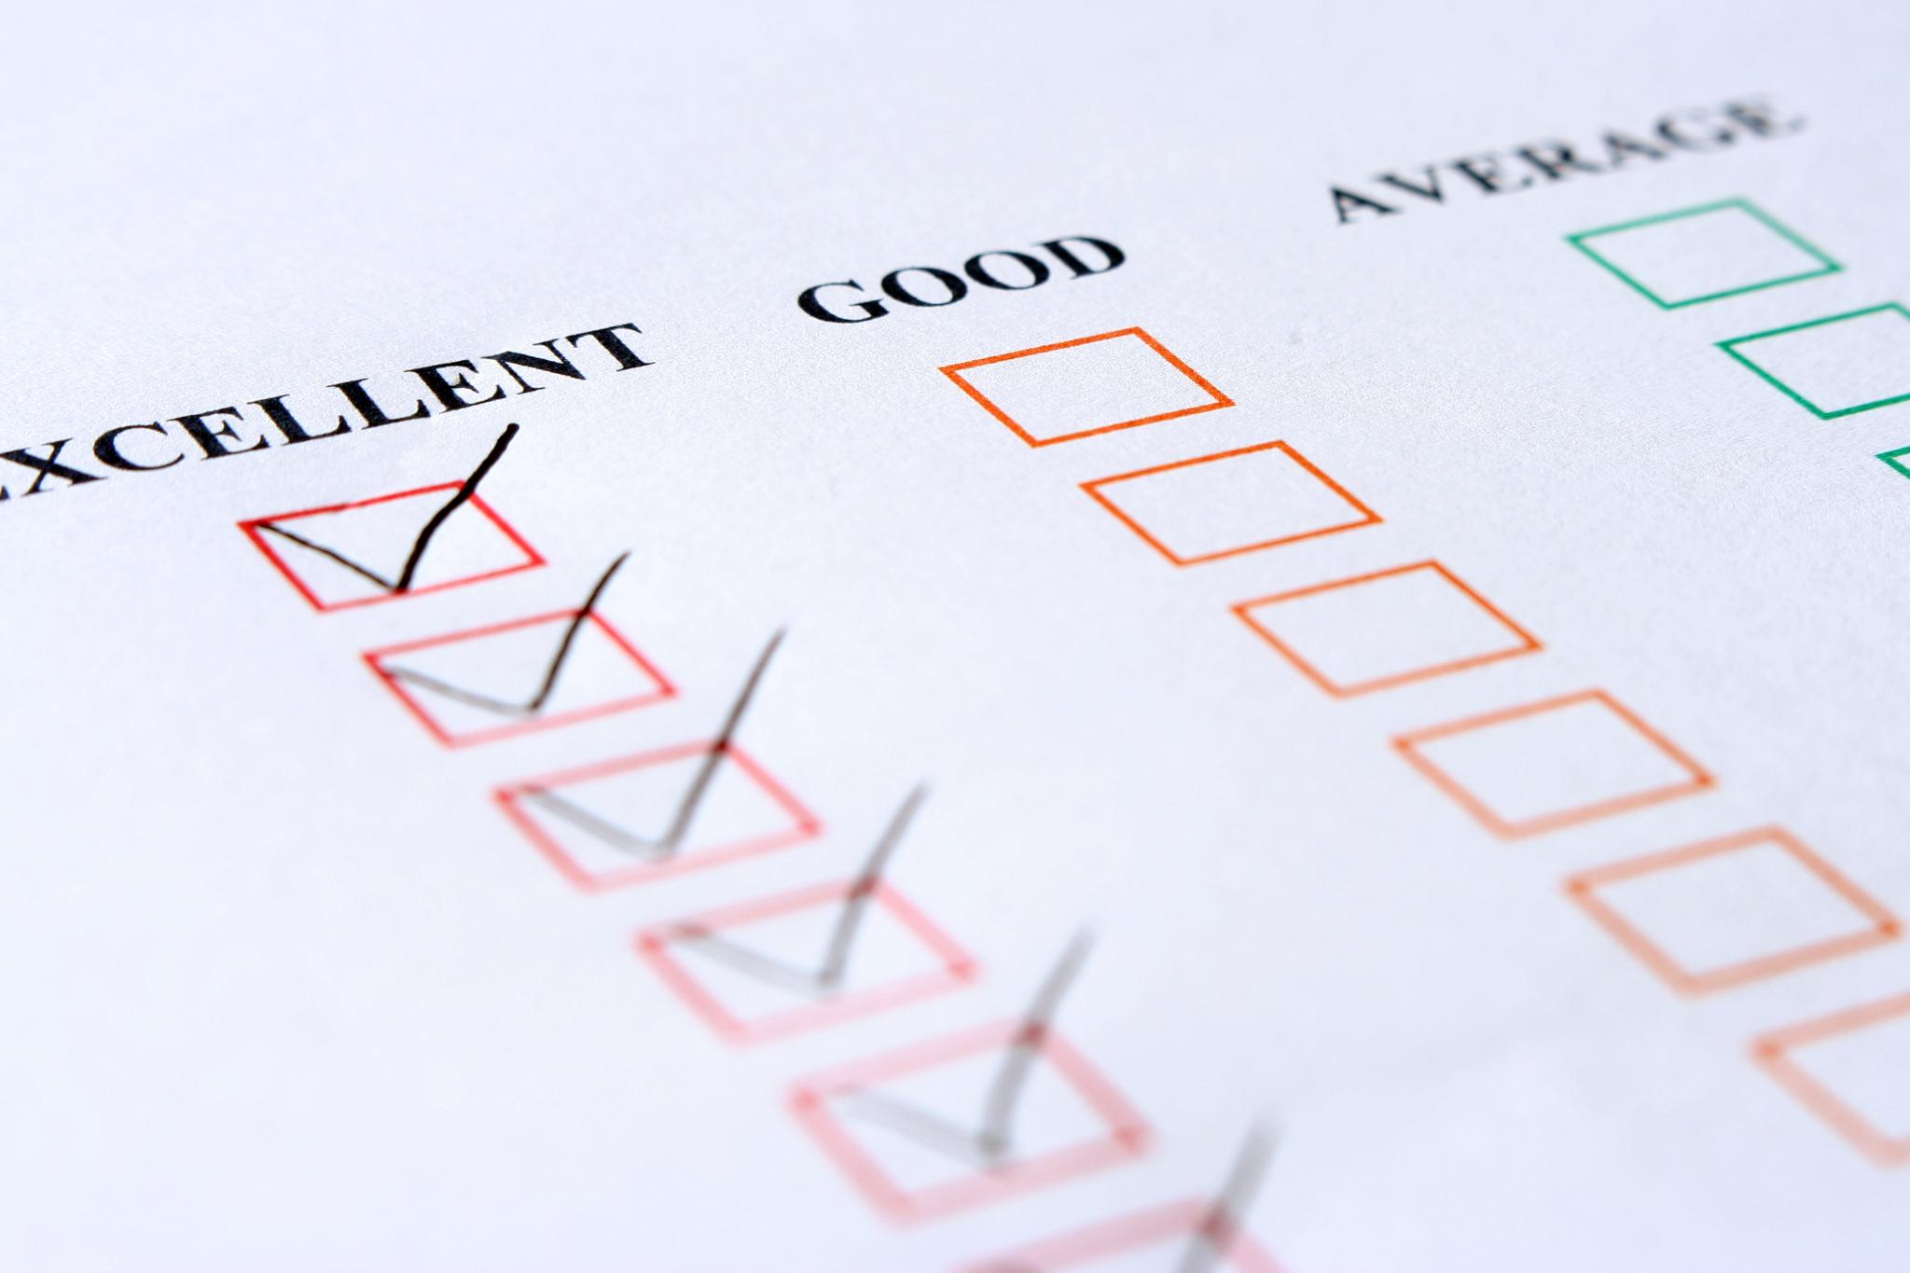
Securing Sponsored Event Insurance
Review Insurance Policy
  Check the policy for eligible events and coverage limits to ensure your event qualifies for protection.
Notify Provider and Submit Details
  Contact the insurance provider or broker and provide a detailed description including the event’s date, location, and activities.
Obtain Written Confirmation
  Fulfill requirements, address recommendations, and get written proof of coverage for your records.
Document Communication and Records
  Keep copies of all communications and documents to ensure future reference and compliance.

Slide 8
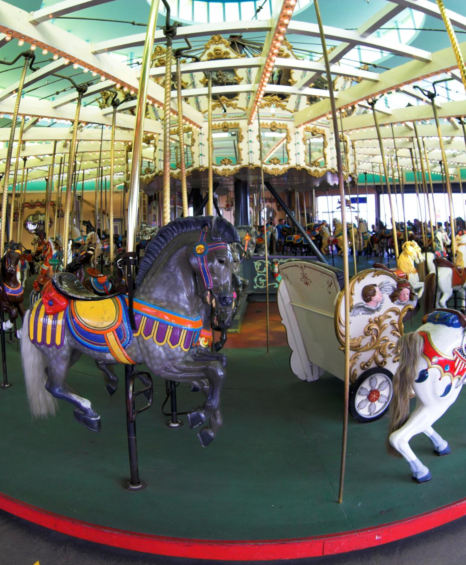
Vendor Agreements, Food Safety, and Amusement Rides
Vendor Agreements and Insurance
  Require vendors to sign agreements with indemnification and provide proof of liability insurance before event day.
Food Safety Compliance
  Ensure food vendors have health permits, proper refrigeration, and fire safety measures to maintain food safety standards.
Inflatables and Amusement Ride Safety
  Hire professional operators for inflatables and rides, inspect equipment, and implement safety plans for weather and crowd control.

Slide 9
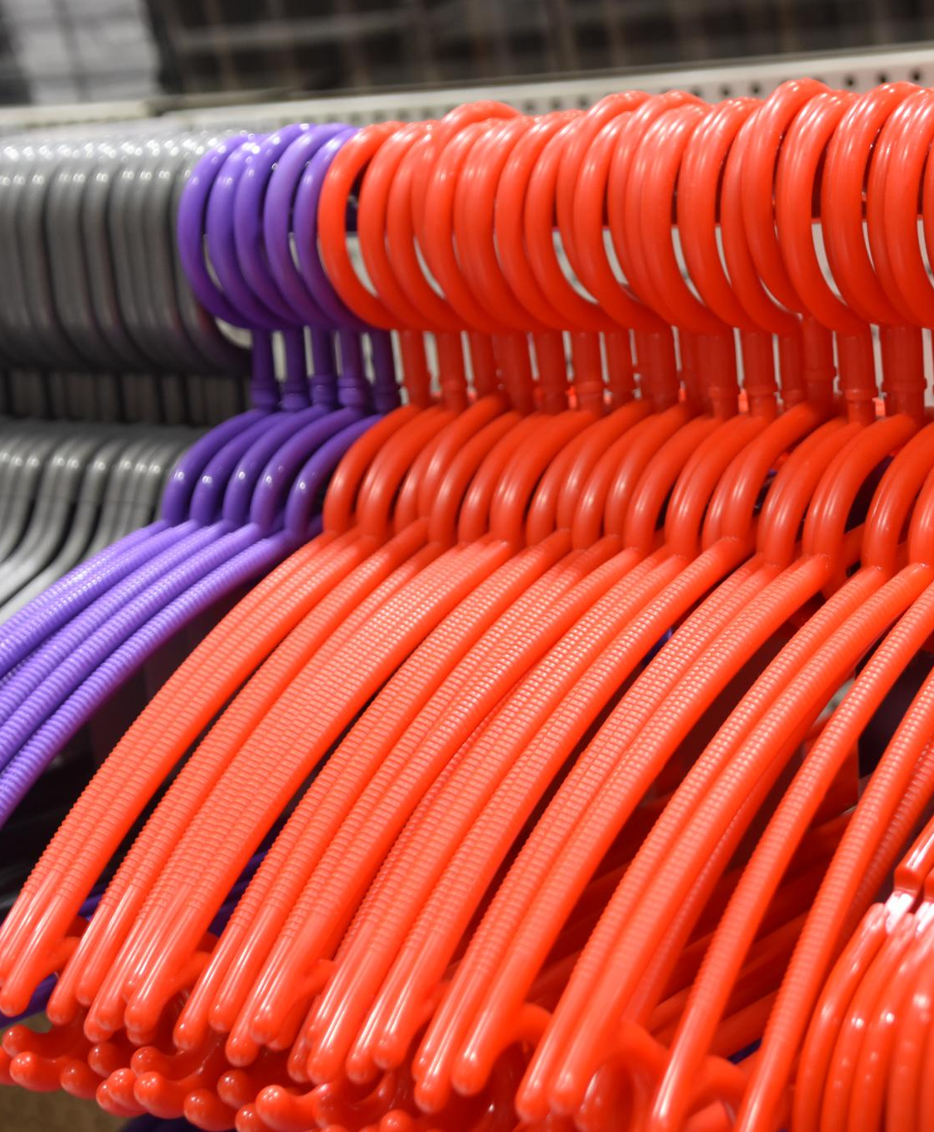
Venue Inspection, Utilities, and Sanitation
Venue Safety Inspection
  Inspect all structures for stability and compliance. Ensure walking surfaces are safe.
Utilities Setup and Compliance
  Qualified electricians must install and inspect temporary electrical systems. Ensure grounding and fire safety compliance.
Sanitation and Facilities Planning
  Provide adequate restrooms and hand-washing stations. Arrange trash and recycling to maintain cleanliness and health safety.
Notes:
Site Preparation & Infrastructure
Inspect the venue for hazards: Before the event, have building inspectors or safety officials examine all structures (grandstands, stages, tents) for stability and code compliance . Check that walking surfaces are even and clear of trip hazards . Ensure any cables or cords are secured and out of footpaths (use cable covers). For outdoor sites, consider terrain – e.g. fill small holes, mark any obstacles, and restrict access near water bodies or steep slopes unless protections are in place . Document these inspections and follow up on issues found.
Utilities and equipment: If using temporary electrical systems, lighting, or generators, have a qualified electrician set them up and inspect them. Ensure compliance with electrical codes (e.g. proper grounding, GFCI protection where needed). Locate power cables away from public areas or shield them. If stages or large tents are erected, they often require an inspection by building or fire officials for structural safety and proper anchoring (especially in wind). All tents/canopies should be flame-retardant per fire codes.
Sanitation and facilities: Provide adequate restroom facilities for the expected crowd. A common guideline is roughly 1 toilet per 200–300 people for large events (varies with event duration) . If permanent restrooms are insufficient, rent portable toilets (including accessible units for people with disabilities) . Arrange for hand-washing stations or sanitizer. Plan for trash and recycling collection – have enough receptacles placed throughout the venue and schedule pickups to prevent overflow. Adequate sanitation not only improves attendee experience but also prevents health hazards.
Image source: Microsoft 365 content library

Slide 10
Venue Inspection, Utilities, and Sanitation
Venue Safety Inspection
  Inspect all structures for stability and compliance. Ensure walking surfaces are safe.
Utilities Setup and Compliance
  Qualified electricians must install and inspect temporary electrical systems. Ensure grounding and fire safety compliance.
Sanitation and Facilities Planning
  Provide adequate restrooms and hand-washing stations. Arrange trash and recycling to maintain cleanliness and health safety.
Notes:
Site Preparation & Infrastructure
Inspect the venue for hazards: Before the event, have building inspectors or safety officials examine all structures (grandstands, stages, tents) for stability and code compliance . Check that walking surfaces are even and clear of trip hazards . Ensure any cables or cords are secured and out of footpaths (use cable covers). For outdoor sites, consider terrain – e.g. fill small holes, mark any obstacles, and restrict access near water bodies or steep slopes unless protections are in place . Document these inspections and follow up on issues found.
Utilities and equipment: If using temporary electrical systems, lighting, or generators, have a qualified electrician set them up and inspect them. Ensure compliance with electrical codes (e.g. proper grounding, GFCI protection where needed). Locate power cables away from public areas or shield them. If stages or large tents are erected, they often require an inspection by building or fire officials for structural safety and proper anchoring (especially in wind). All tents/canopies should be flame-retardant per fire codes.
Sanitation and facilities: Provide adequate restroom facilities for the expected crowd. A common guideline is roughly 1 toilet per 200–300 people for large events (varies with event duration) . If permanent restrooms are insufficient, rent portable toilets (including accessible units for people with disabilities) . Arrange for hand-washing stations or sanitizer. Plan for trash and recycling collection – have enough receptacles placed throughout the venue and schedule pickups to prevent overflow. Adequate sanitation not only improves attendee experience but also prevents health hazards.
Image source: Microsoft 365 content library

Slide 11
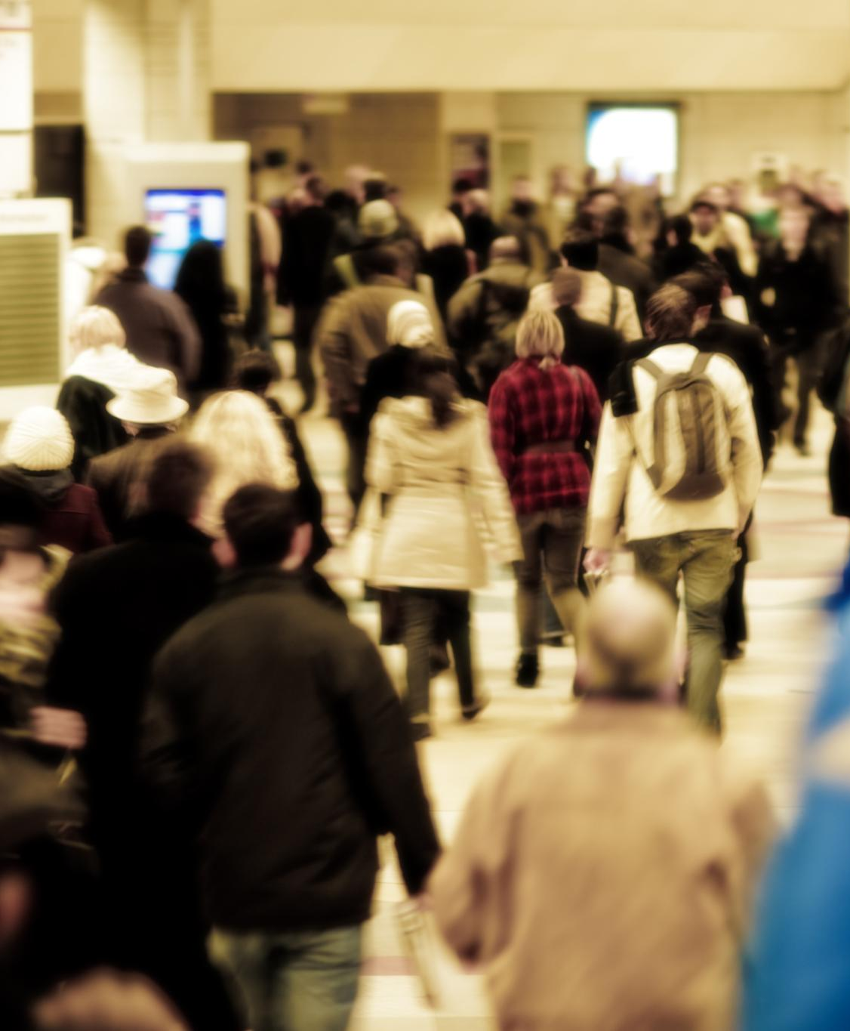
Ingress/Egress, Bag Checks, and Lost Child Procedures
Controlled Ingress and Egress
  Use timed entry and phased exit strategies with staff guidance to prevent crowd surges and bottlenecks.
Bag Checks and Screenings
  Implement bag inspections and metal detector screenings with clear signage and amnesty bins for safety.
Lost Child and Lost & Found Procedures
  Establish lost child centers and lost & found areas with trained staff to ensure safe reunification and item recovery.

Slide 12
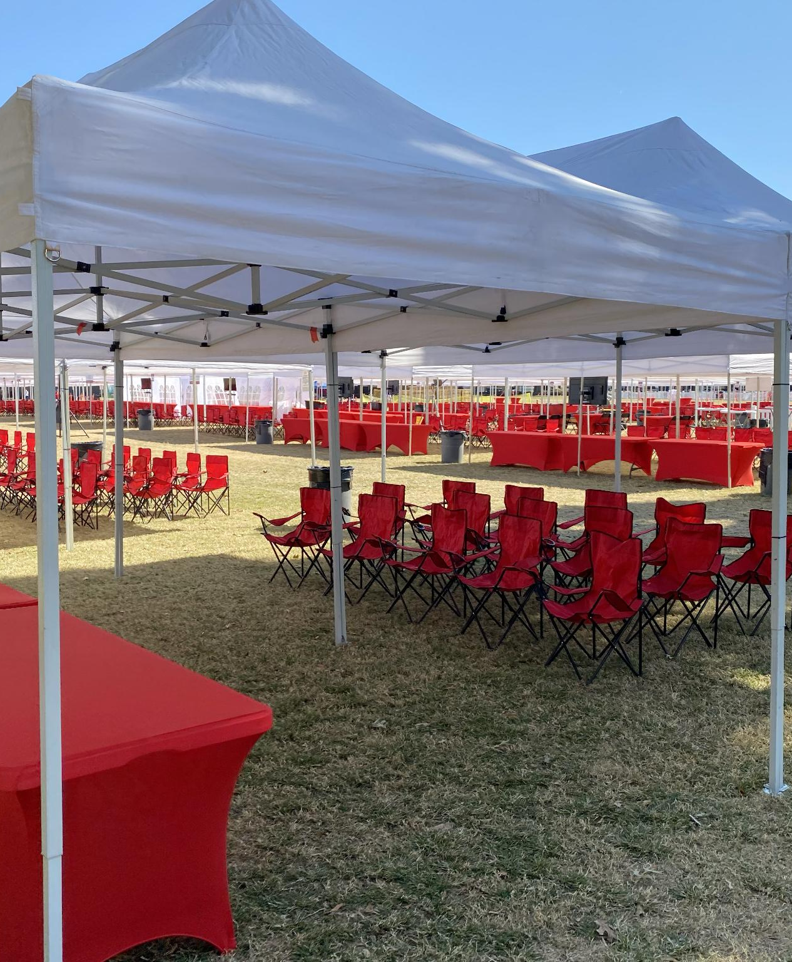
Water, Shade, Cooling, and Accessibility Considerations
Hydration and Cooling Measures
  Ensure water stations, shaded areas, and cooling tents are available for hot weather and physical activities.
Cold Weather Provisions
  Provide warming areas, hot drinks, and mitigate icy conditions during winter events for attendee safety.
Accessibility for Disabilities
  Ensure accessible parking, viewing areas, restrooms, and navigable paths for wheelchairs at event venues.

Slide 13
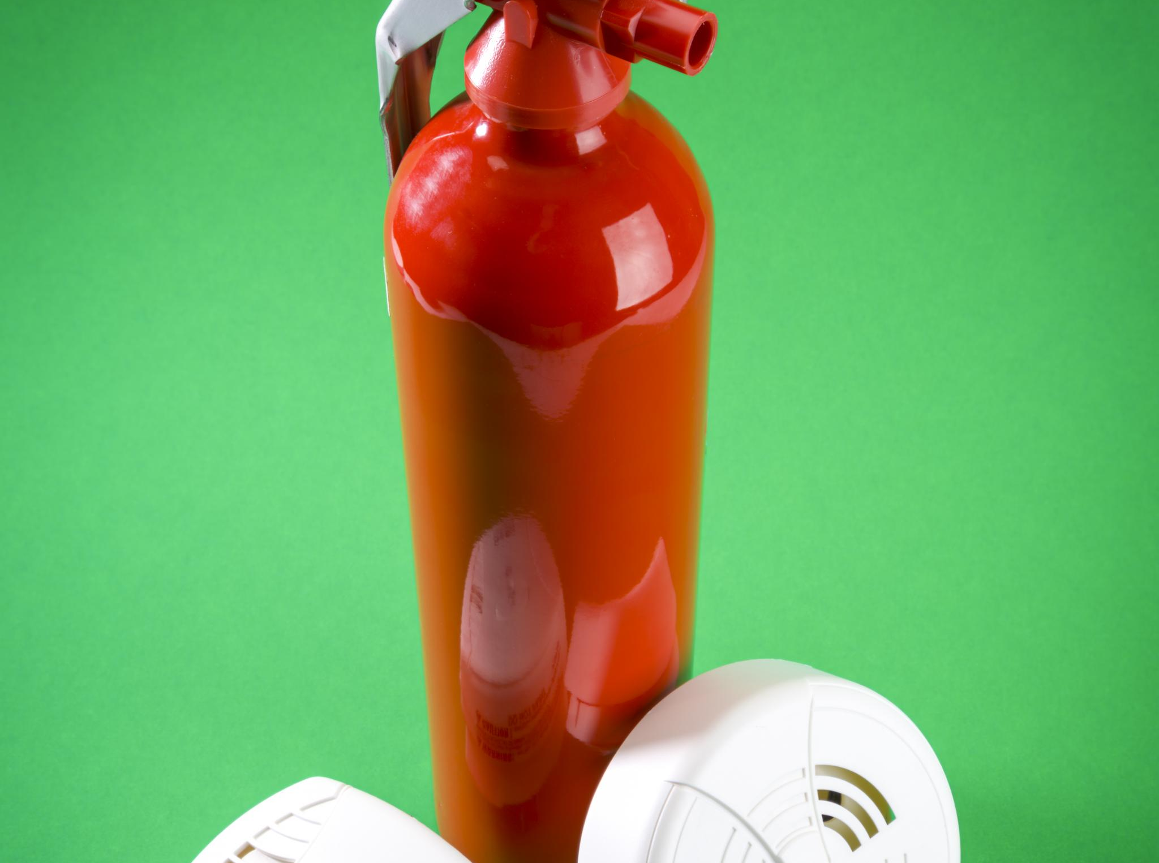
Alcohol Controls, Parade Float Safety, Pyrotechnics, and Waivers
Alcohol Control Measures
  Strict monitoring and ID checks help enforce alcohol laws and reduce liability at events with alcohol.
Parade Float Safety
  Safety rules for floats include adult supervision, secure handholds, spaced floats, and spotters to protect attendees.
Pyrotechnics and Fire Safety
  Fireworks and open flames require permits, licensed operators, safety perimeters, and fire department oversight.
Liability Waivers
  Waivers for high-risk activities clarify risks and provide legal protection for event organizers.

Slide 14
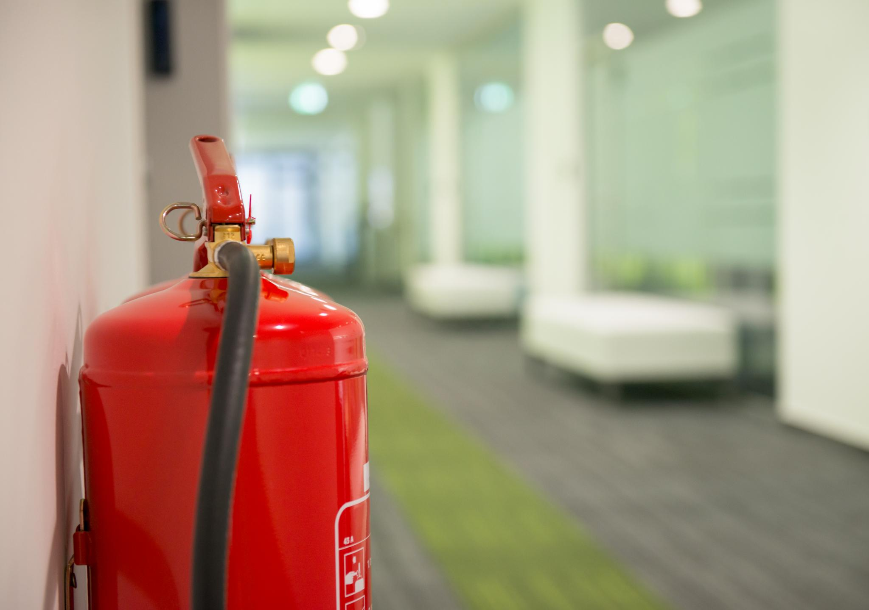
Fire Code Compliance and On-Site Firefighting Resources
Fire Code Compliance
  Coordinate with the fire marshal and adhere to occupancy limits and flame-retardant tent regulations for event safety.
Open Flame and Pyrotechnics Permits
  Obtain permits for grills, heaters, and fireworks; ensure licensed professionals handle pyrotechnics safely.
On-Site Firefighting Resources
  Station fire engine crews for high-risk events and strategically place appropriate fire extinguishers with trained staff.
Emergency Communication
  Maintain direct communication between event control and local fire station for rapid response to fire alarms.

Slide 15
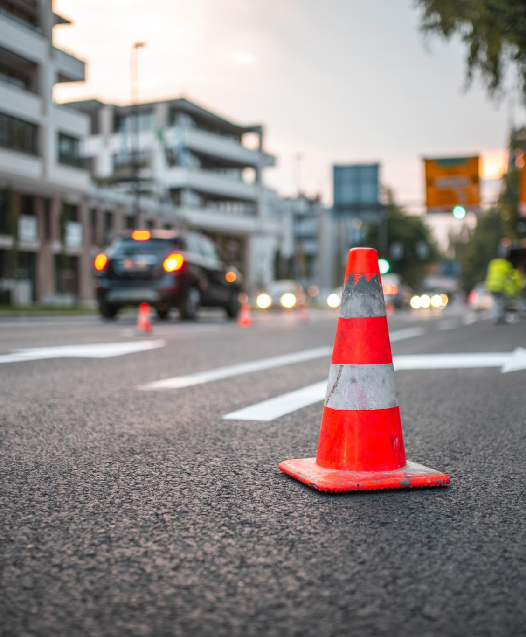
Traffic Control, Parking, and Pedestrian Safety
Traffic Control Planning
  Coordinate with traffic authorities to plan road closures and detours; use signage and barricades to guide traffic effectively.
Parking Management
  Designate and manage parking areas with attendants; consider satellite lots and shuttles to reduce congestion and ensure accessible parking.
Pedestrian Safety Measures
  Provide safe walking paths, temporary crosswalks, crossing guards, and good lighting to protect pedestrians near event roads.

Slide 16
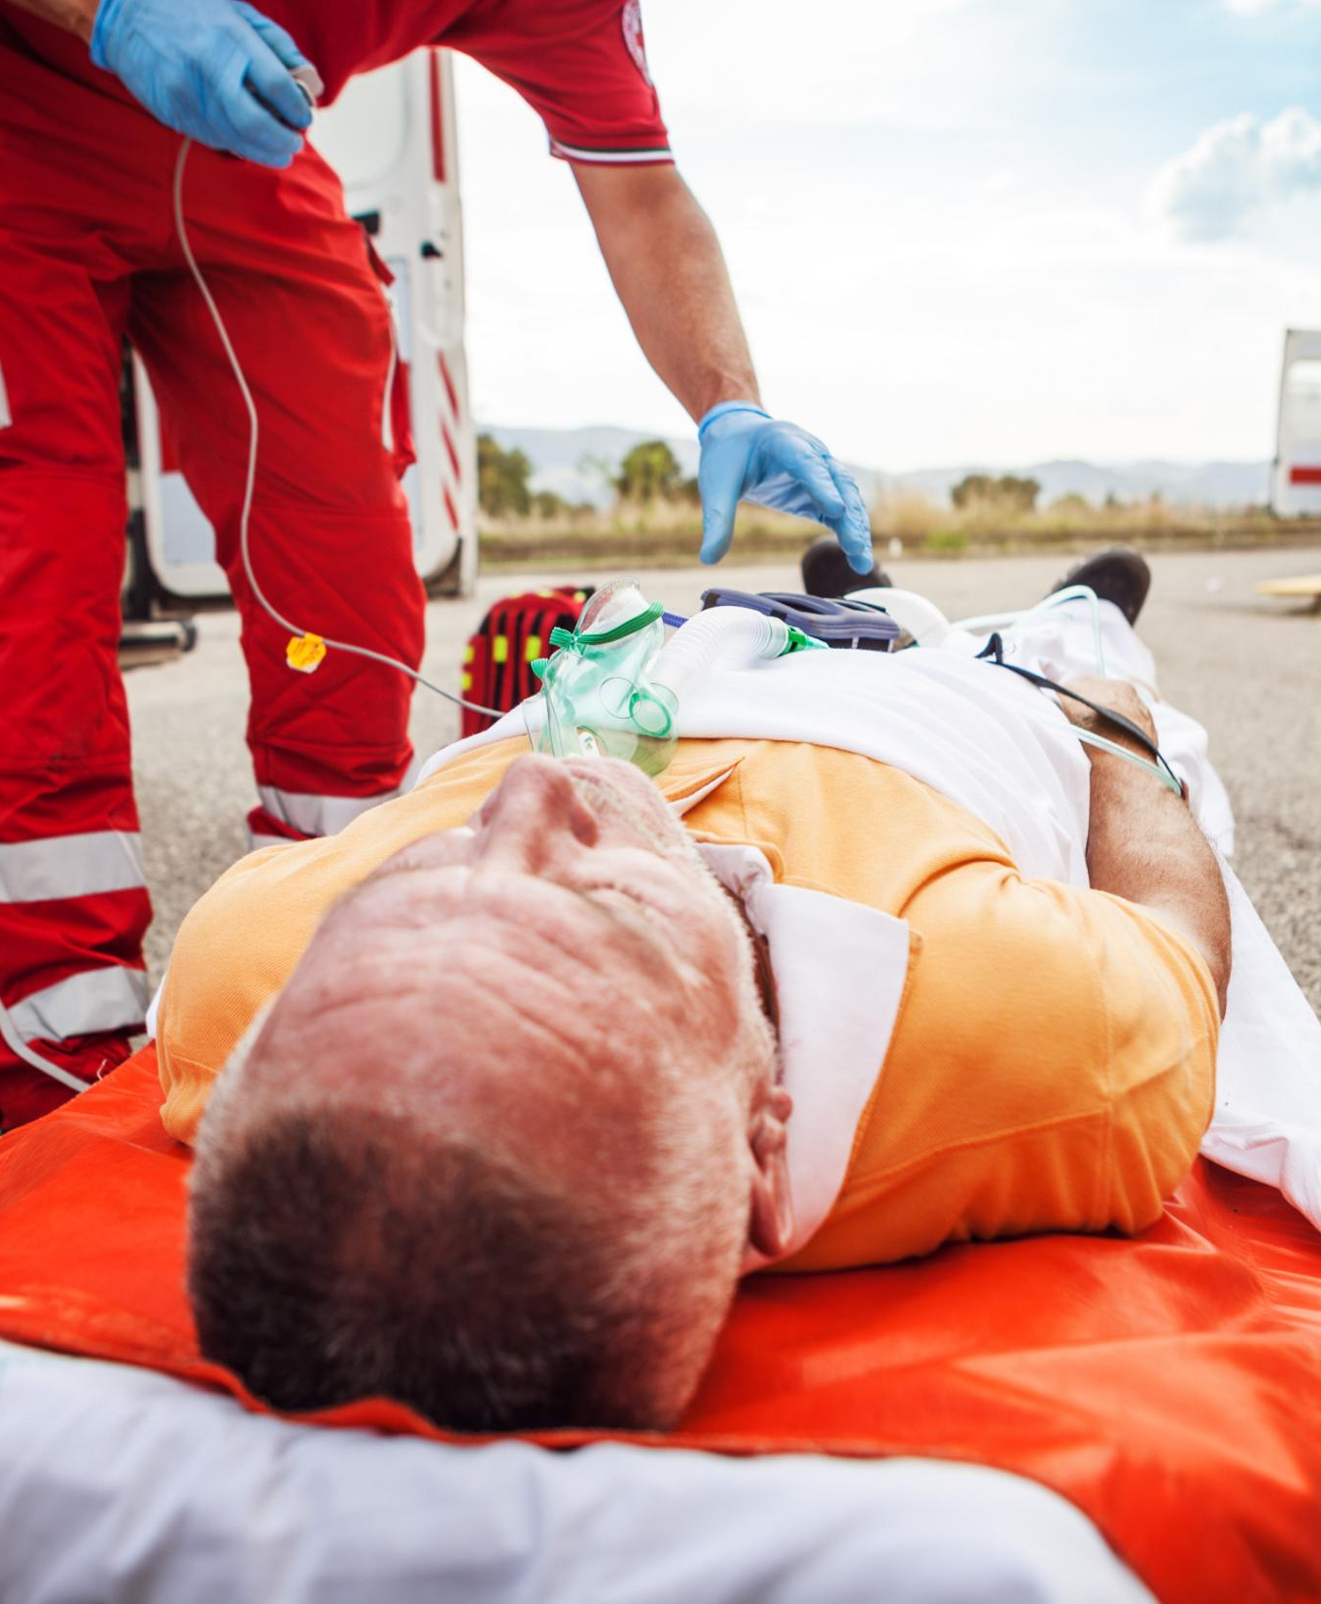
EMS Coverage, First Aid, and Emergency Response Planning
EMS Coverage at Events
  Ensure emergency medical services are readily available by contracting ambulances, first aid tents, or roaming medical teams.
First Aid and Supplies
  Provide basic first aid kits and consider first aid booths with AEDs and trained personnel for larger events.
Emergency Response Planning
  Develop and practice an incident response plan including evacuation routes, communication methods, and staff roles during emergencies.

Slide 17

Security Staffing and Crowd Flow Control
Security Staffing Coordination
  Coordinate with police and or organizer’s private security to ensure adequate staffing based on crowd size and event specifics.
Clear Role Assignments
  Assign clear roles to security staff such as crowd patrol, stage monitoring, and parking management for effective control.
Crowd Flow Design
  Use barriers and multiple entry points to prevent bottlenecks and control crowd movement safely.
Capacity and Exit Safety
  Monitor crowd capacity to avoid overcrowding and keep all exits clearly marked and unobstructed.

Slide 18
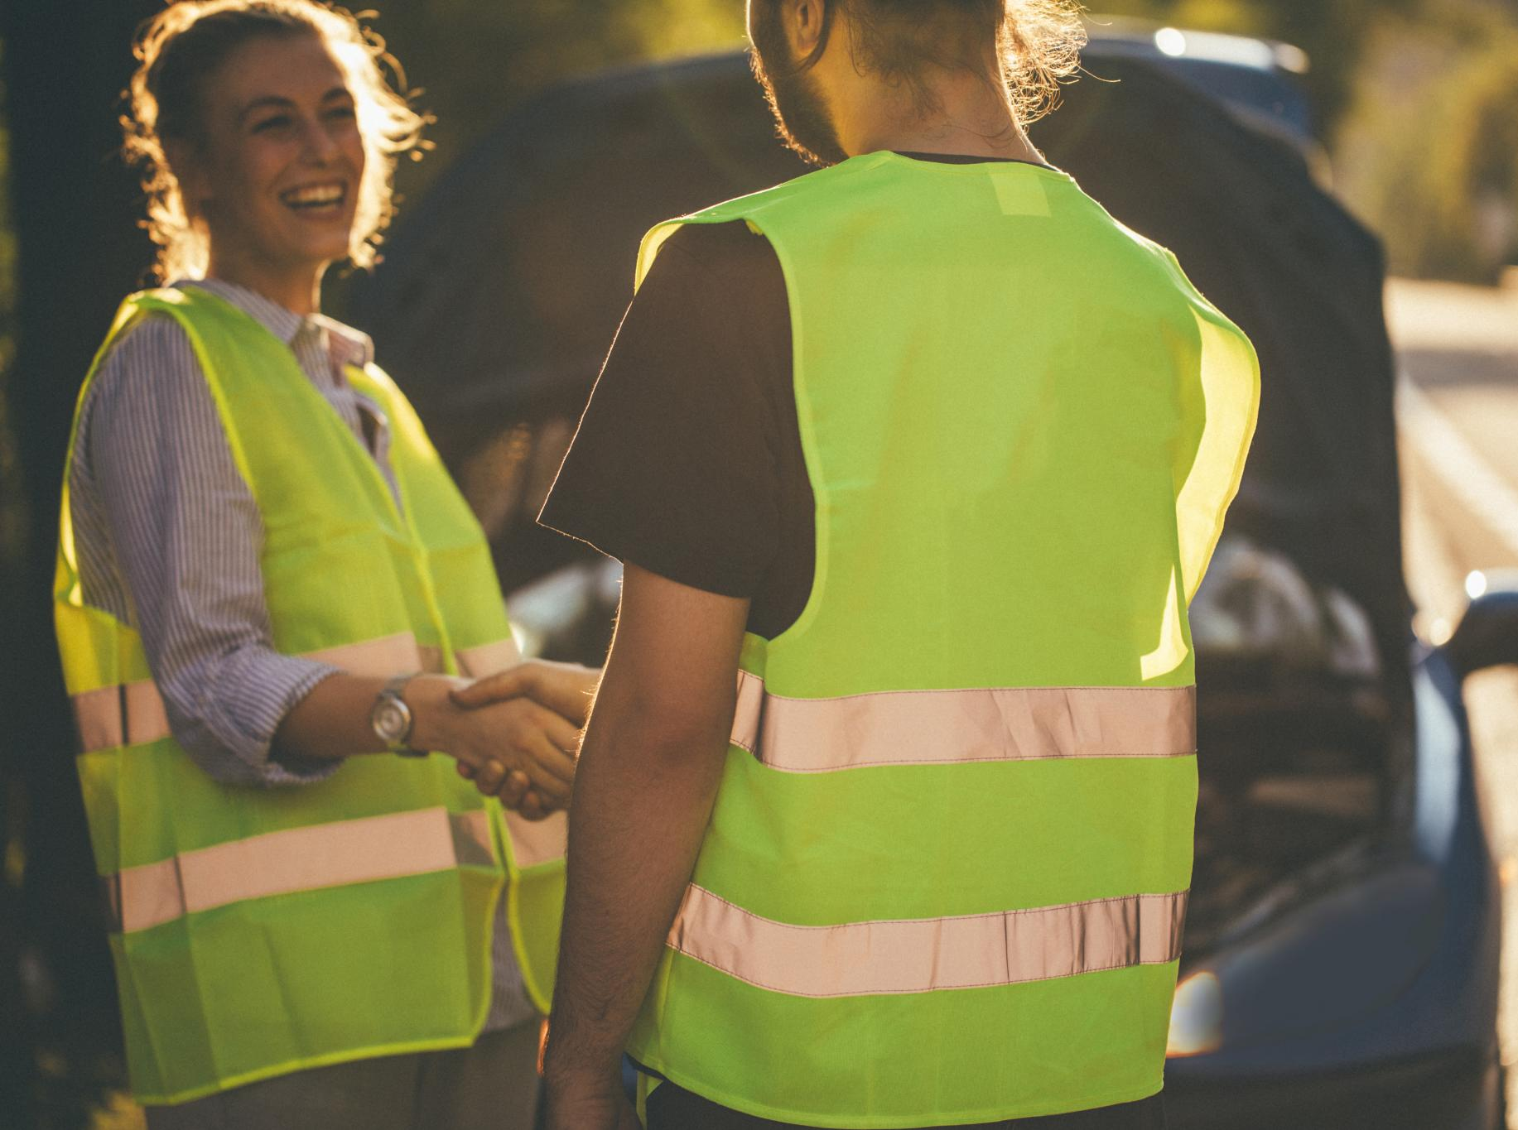
Managing Disruptions and Incident Response
Plan for Disruptions
  Develop clear procedures to handle unruly behavior and fights during events. Alert police rather than intervening physically unless trained.
Protest Area and Monitoring
  Designate specific protest areas at political events and have police monitor to separate opposing groups effectively.
De-escalation and Escorting
  Empower security to calmly de-escalate minor arguments and escort intoxicated or disorderly individuals out safely.
Incident Documentation
  Document all ejections and incidents thoroughly for effective post-event review and future planning.

Slide 19

Emergency Vehicle Access and Controlled Egress
Clear Emergency Access Routes
  Maintain open and clear primary routes for ambulances and fire trucks during events to ensure rapid emergency response.
Communication with Dispatch
  Inform fire and EMS dispatch about event locations and best access points to reduce response time during emergencies.
Staff at Barricades
  Station trained staff with radios at barricades to quickly move obstacles and allow emergency vehicles through.
Controlled Traffic Egress
  Use police or staff to manage intersections after events to efficiently move traffic and restore normal flow.

Slide 20

Workers’ Compensation and Incident Documentation
Workers’ Compensation Coverage
  Ensure all municipal employees and volunteers are properly covered by workers’ compensation or accident insurance.
Volunteer Safety Guidelines
  Brief volunteers on safety protocols and limit their roles to non-hazardous tasks to reduce risk.
Incident Documentation
  Keep detailed records of contracts, permits, and incident reports, including photos and witness accounts.
Prompt Incident Notification
  Notify insurers or risk managers immediately after significant incidents to aid claims defense.

Slide 21
Contact Information
Susan O’Rorke
President, NYMIR Division Wright Public Entity
12 Metro Park Road, Colonie, NY 12204
sororke@wrightinsurance.com
Tel: 518-421-9939

